Slide 1
Detection of Deepfakes Review of Bispectral Analysis
Speech Group 19/06/2024
Anthony White

Slide 2

Synthetic Peter made with FastSpeech 2
Hello, my name is Peter
Today, it is raining
Sunday is the best day of the week because it is the weekend
The Quefrency Alanysis of Time Series for Echoes

Slide 3
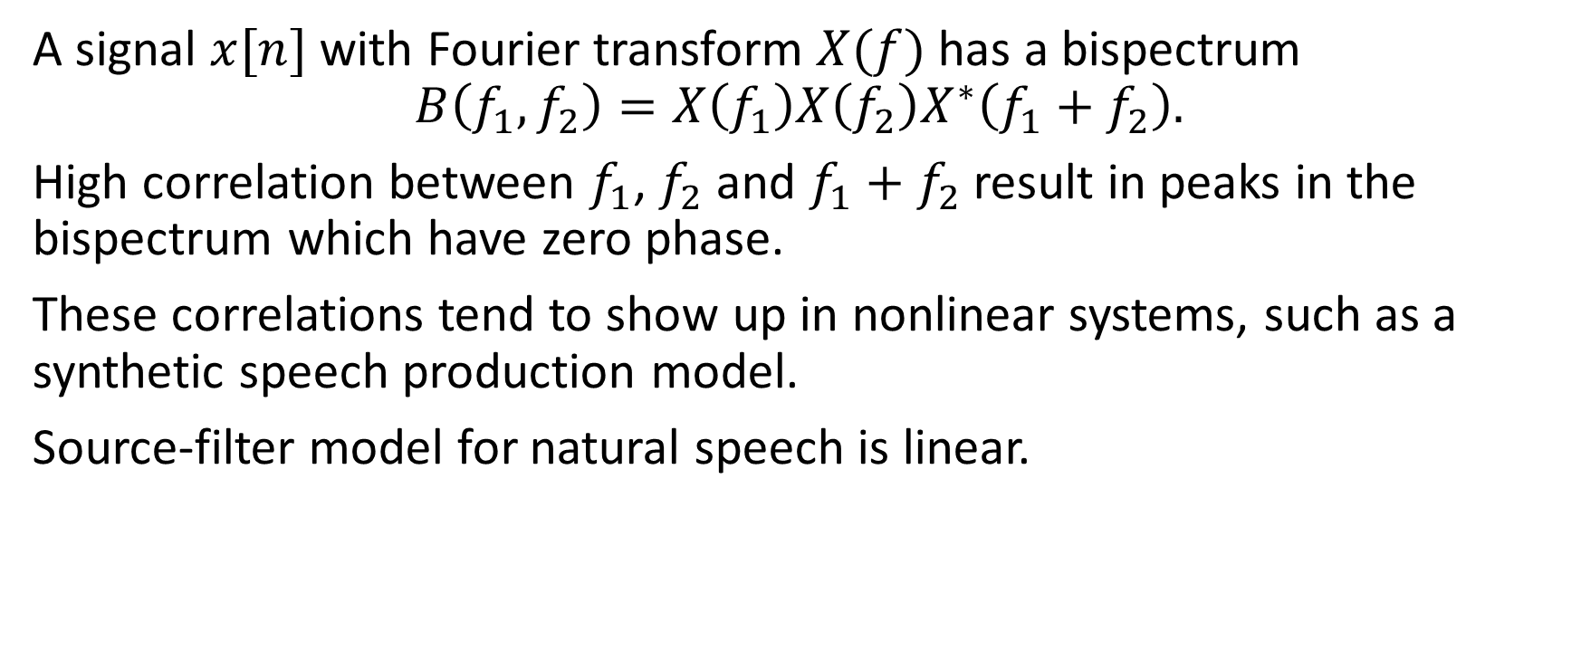
Overview
A signal $x[n]$ with Fourier transform $X(f)$ has a bispectrum
$$B\left(f_{1},f_{2}\right)=X\left(f_{1}\right)X\left(f_{2}\right)X^{∗}\left(f_{1}+f_{2}\right).$$
High correlation between $f_{1}$, $f_{2}$ and $f_{1}+f_{2}$ result in peaks in the bispectrum which have zero phase.
These correlations tend to show up in nonlinear systems, such as a synthetic speech production model.
Source-filter model for natural speech is linear.

Slide 4
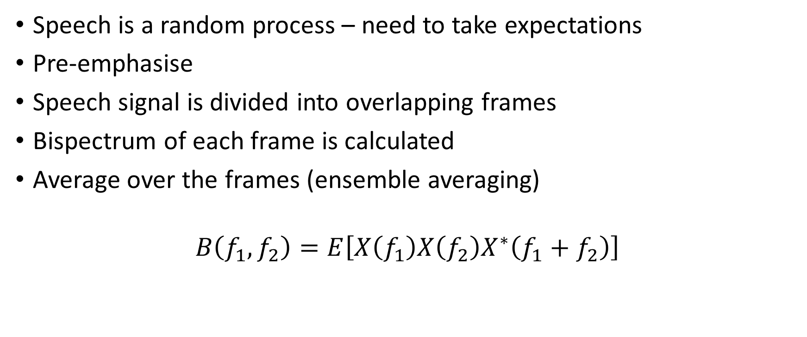
Computing the Bispectrum
Speech is a random process – need to take expectations
Pre-emphasise
Speech signal is divided into overlapping frames
Bispectrum of each frame is calculated
Average over the frames (ensemble averaging)
$$B\left(f_{1},f_{2}\right)=E\left[X\left(f_{1}\right)X\left(f_{2}\right)X^{∗}\left(f_{1}+f_{2}\right)\right]$$

Slide 5
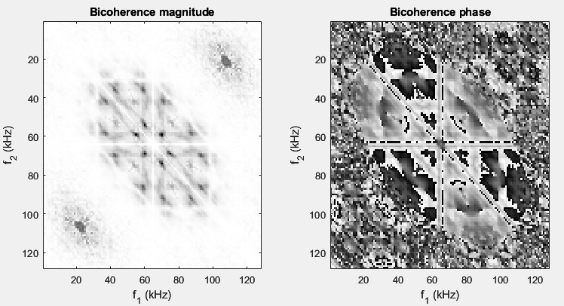
Example

Slide 6
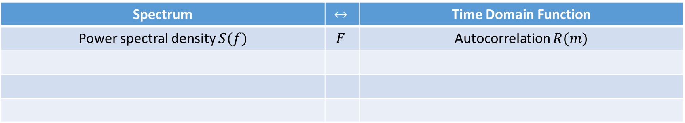
Big Picture of Polyspectra
Spectrum | $$↔$$ | Time Domain Function
Power spectral density $S(f)$ | $$F$$ | Autocorrelation $R(m)$
WK

Slide 7
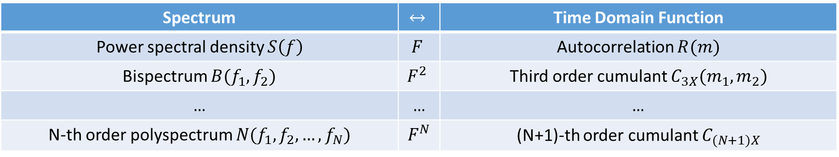

Big Picture of Polyspectra
Spectrum | $$↔$$ | Time Domain Function
Power spectral density $S\left(f\right)$ | $$F$$ | Autocorrelation $R(m)$
Bispectrum $B(f_{1},f_{2})$ | $$F^{2}$$ | Third order cumulant $C_{3X}(m_{1},m_{2})$
… | … | …
N-th order polyspectrum $N(f_{1},f_{2},…,f_{N})$ | $$F^{N}$$ | (N+1)-th order cumulant $C_{(N+1)X}$
WK
$$S\left(f\right)=E\left[X\left(f\right)X^{∗}(f)\right]$$
$B\left(f_{1},f_{2}\right)=$ $E\left[X\left(f_{1}\right)X\left(f_{2}\right)X^{∗}\left(f_{1}+f_{2}\right)\right]$
$$N\left(f_{1},f_{2},…,f_{N}\right)=E\left[\prod_{n=1}^{N}{X(f_{n})}∙X^{∗}\left(\sum_{n=1}^{N}{f_{n}}\right)\right]$$

Slide 8
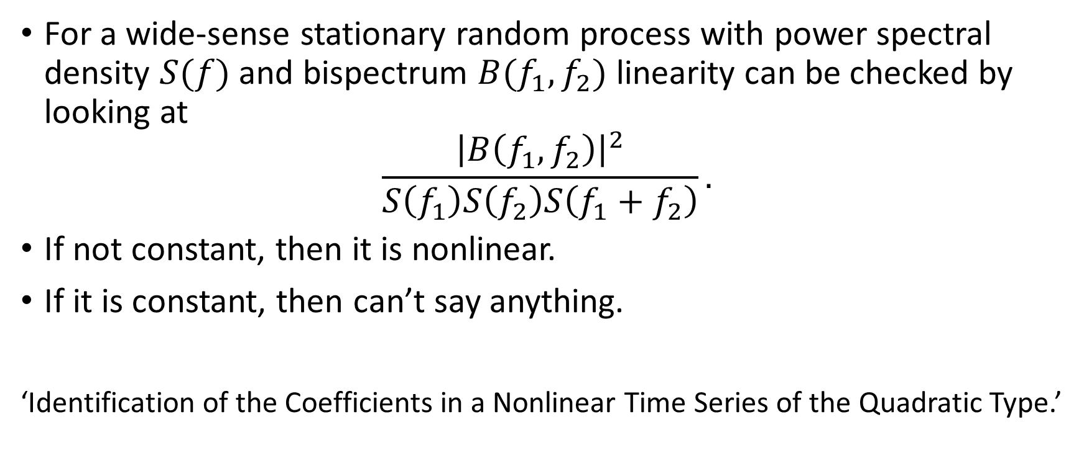
Hinich and Patterson
For a wide-sense stationary random process with power spectral density $S(f)$ and bispectrum $B(f_{1},f_{2})$ linearity can be checked by looking at
$$\frac{{\left|B\left(f_{1},f_{2}\right)\right|}^{2}}{S\left(f_{1}\right)S\left(f_{2}\right)S\left(f_{1}+f_{2}\right)}.$$
If not constant, then it is nonlinear.
If it is constant, then can’t say anything.
‘Identification of the Coefficients in a Nonlinear Time Series of the Quadratic Type.’

Slide 9
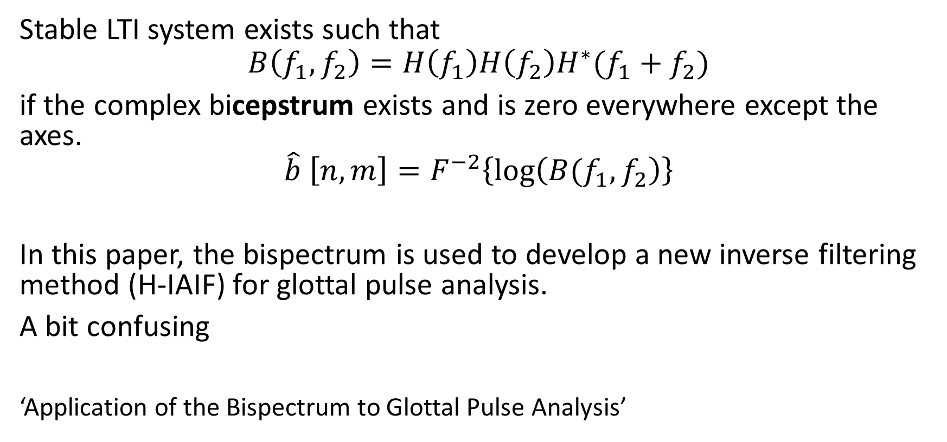
Walker
Stable LTI system exists such that
$$B\left(f_{1},f_{2}\right)=H\left(f_{1}\right)H\left(f_{2}\right)H^{∗}(f_{1}+f_{2})$$
if the complex bicepstrum exists and is zero everywhere except the axes.
$$\hat{b} \left[n,m\right]=F^{−2}\left\{\log\left(B(f_{1},f_{2}\right)\right\}$$
In this paper, the bispectrum is used to develop a new inverse filtering method (H-IAIF) for glottal pulse analysis.
A bit confusing
‘Application of the Bispectrum to Glottal Pulse Analysis’

Slide 10
Time-varying bispectrum
Looking for patterns in the bispectrum over time
Looking for changes in the first four statistical moments over time
Mean, variance, skewness, kurtosis
Bispectrogram ?

Slide 11
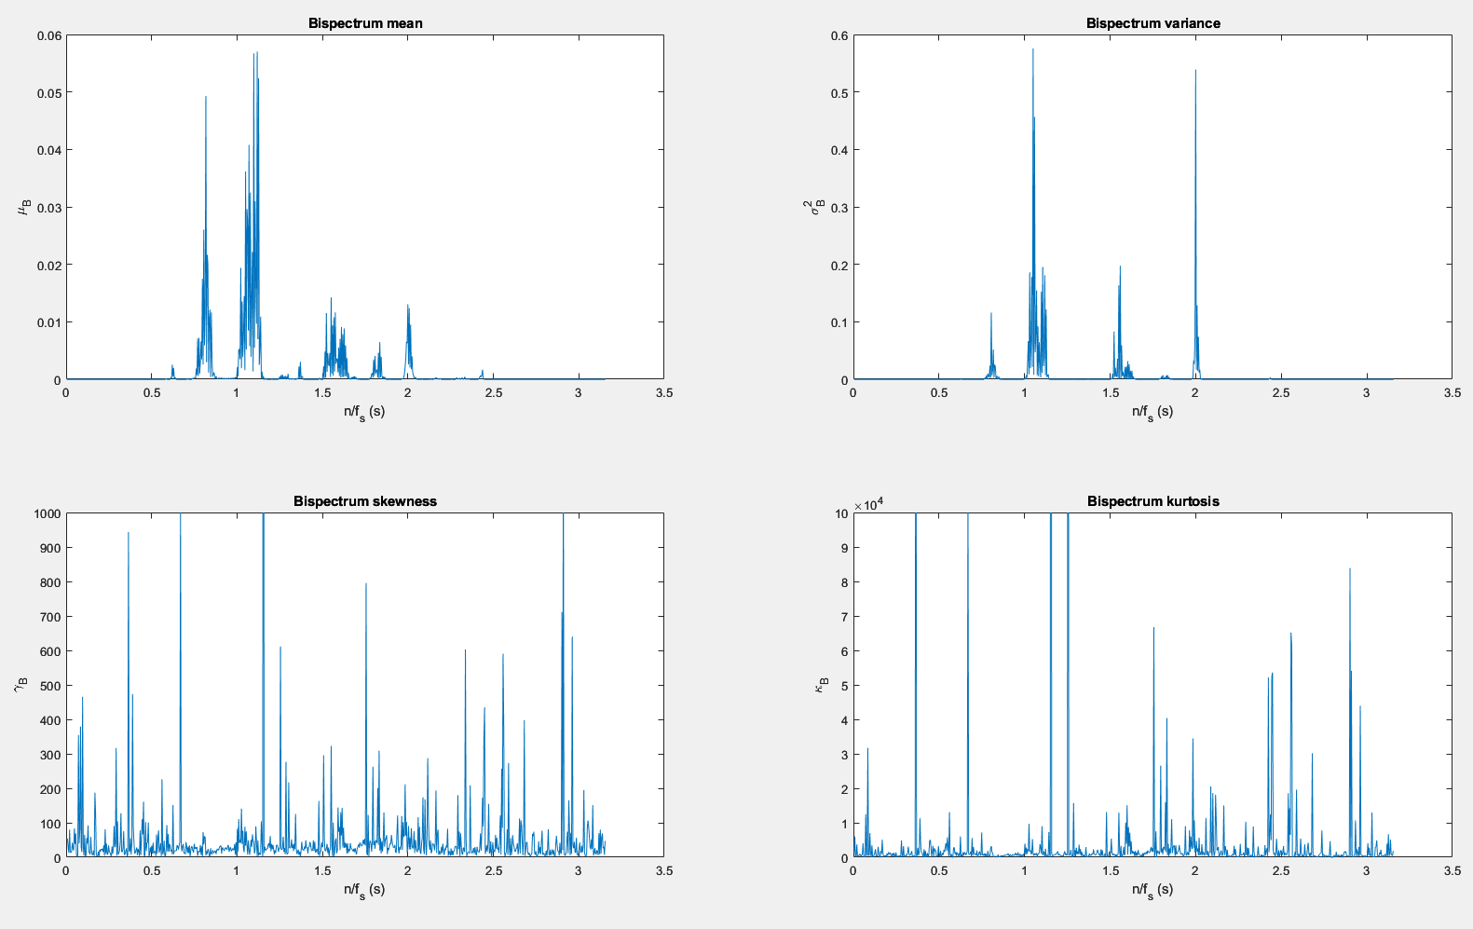
Natural

Slide 12
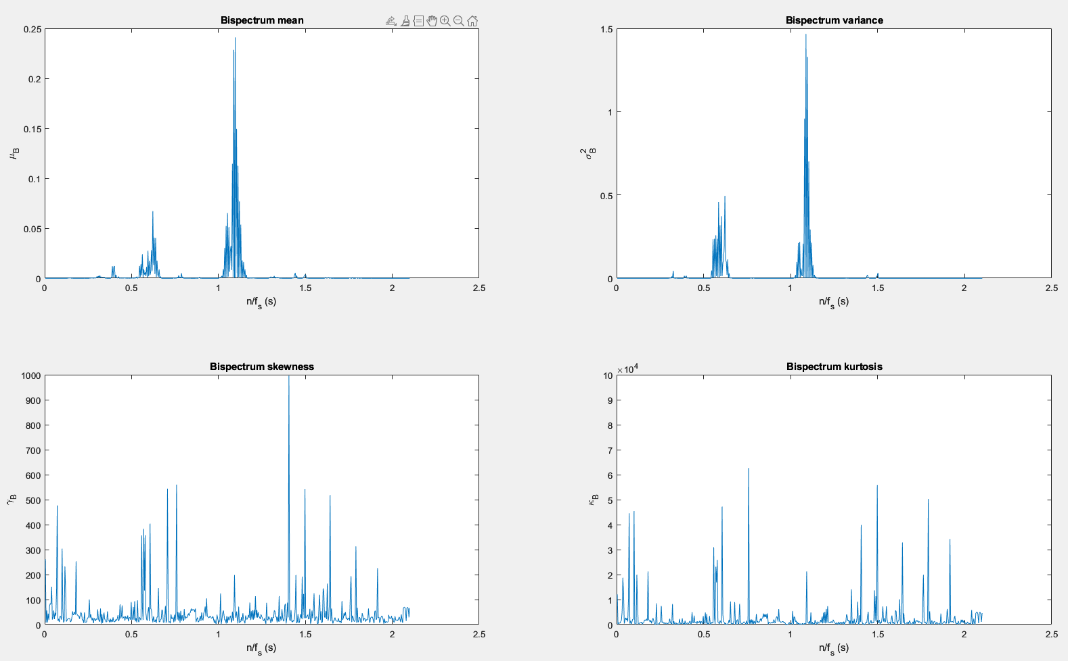
Synthetic

